Slide 1

Extended telecom service
Bharath TS

Slide 2
Contents
Design/flow details w.r.t NR
01
Additional requirements
02
Use cases
03
Advantages to operator
05
Advantages to user
06
security
04

Slide 3
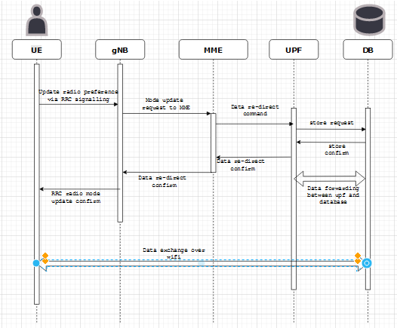
Flow when NR signal is poor

Slide 4
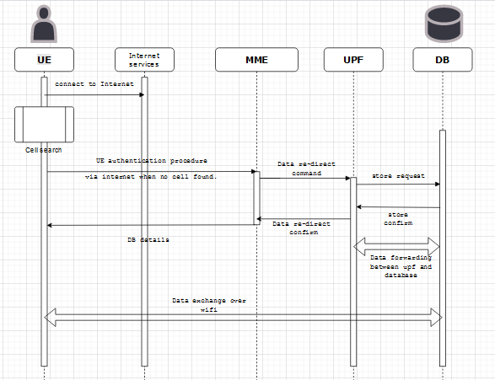
Flow when no NR cell

Slide 5
Additional requirements
- Change in core, new software module to authenticate from public network.
01
- New database (single or multiple) to be added & made accessible to public network.
02
- UE to have new software module to detect/change data transfer mode & support new authentication method.
03

Slide 6
Use cases
Providing/extending telecom(4G/5G) service i.e.. across globe.
01
International roaming, telecom service in remote locations including oceans, across poles etc…
02
Better service when no 4G/5G signal.
03
Charging for service without any radio infrastructure.
04

Slide 7
Use cases
Providing/extending telecom(2G/3G/4G/5G) service area.
01
International roaming, telecom service in remote locations including oceans.
02
Minimal change in architecture(only 4G, 5G are covered here).
03

Slide 8
Security
Authentication still exists, only change being intermediate nodes between MME and UE.
01
Data for UE in data base can be encrypted based on IMSI or any other identity.
02
Application level protocols can also provide additional security i.e.. Say for example, data transfer via https protocol.
03

Slide 9
Advantages to operators
Extending telecom across globe.
01
International roaming, telecom service in remote locations including oceans without any tie-ups with other service providers.
02
Minimal change in architecture(only 4G, 5G are covered here).
03
Charging for services even without radio infrastructure.
04

Slide 10
Advantages to users
Uninterrupted services.
01
No additional procedure while roaming .
02

